Slide 1
Lab 11

Slide 2
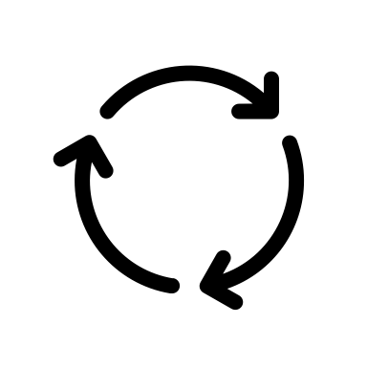
Directed Graph – Cycle Detection
Task: Write a Python function named extractCycle(graph, start).
Input: An adjacency list representing a directed graph and a start node. Output: If the ‘start’ node is part of a cycle, return the cycle as a list of nodes.
Otherwise, return an empty list.
For example, when the method is called with the following graph with start=0,
it should return [0, 1, 2, 4, 0]
0
1
2
3
4
5
Hints: DFS

Slide 3
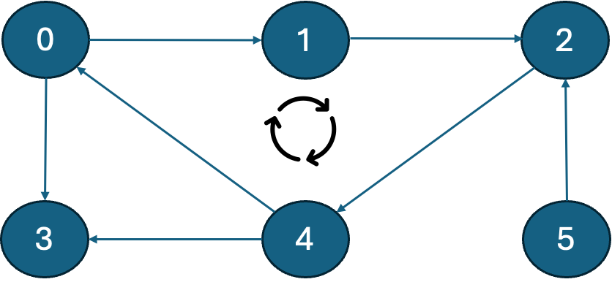
Example Code:
#Adjacency list representing the graph adj = [ [1,3], [2], [4], [], [0,3], [2] ] def extract_cycle(adj_list, start): #TODO: Implement this method print(extract_cycle(adj, 0)) # Should print [0, 1, 2, 4, 0]
print(extract_cycle(adj, 1)) # Should print [1, 2, 4, 0, 1]
print(extract_cycle(adj, 3)) # Should print []

Slide 4
Submission Instructions
Submit the following in iCollege:
Python script/solution (FULL_NAME_Lab11.py)
Due date/time for submission: Within 24 hours from your lab’s end time.
Lab attendance is mandatory. Your iCollege submission will only be considered for grading if you attend the corresponding lab session in-person.
Be prepared to answer a couple of questions on your solution/partial solution during the lab session.

